Slide 1
DELE CA1 RNN
Done By:
Ryan Yeo
P2214452
DAAA/FT/2B/01

Slide 2
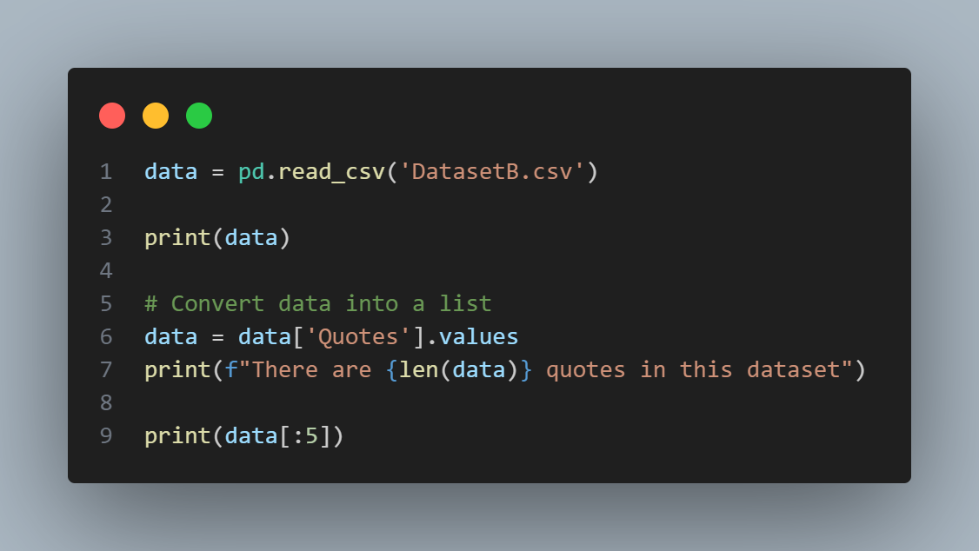
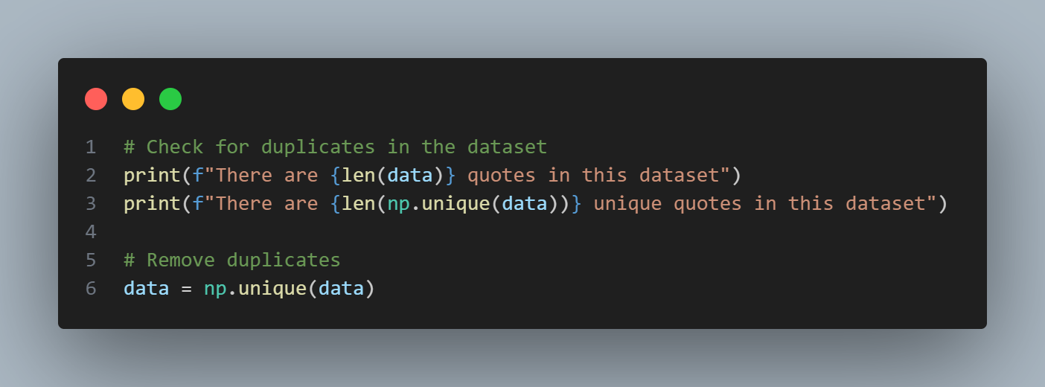
Loading Data
Check Duplicates
["Embrace the beauty of every sunrise; it's a fresh chance to paint your world with joy."
'Embrace challenges; they are the stepping stones to your greatest victories.'
'Embrace the rhythm of life and let it dance through your soul.'
'Embrace kindness, for it has the power to change the world one heart at a time.'
'Embrace the journey, for it leads to the destination of your dreams.']
There are 1000 quotes in this dataset
There are 890 unique quotes in this dataset

Slide 3
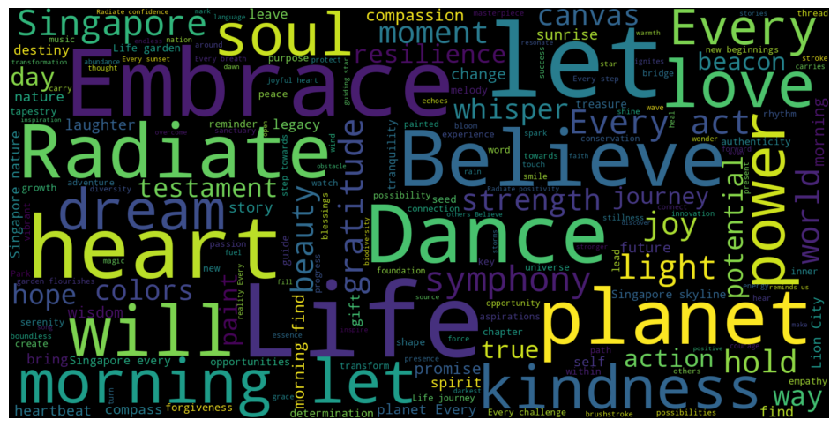
2. EDA
Word Cloud of most common words

Slide 4
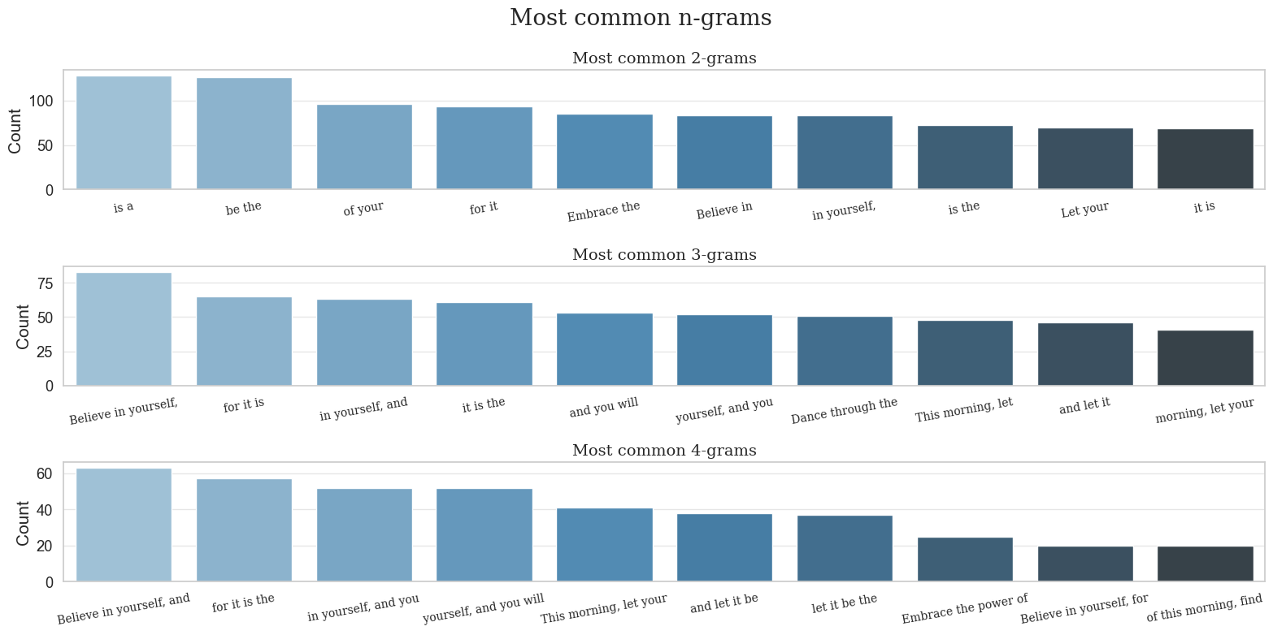
2. EDA

Slide 5
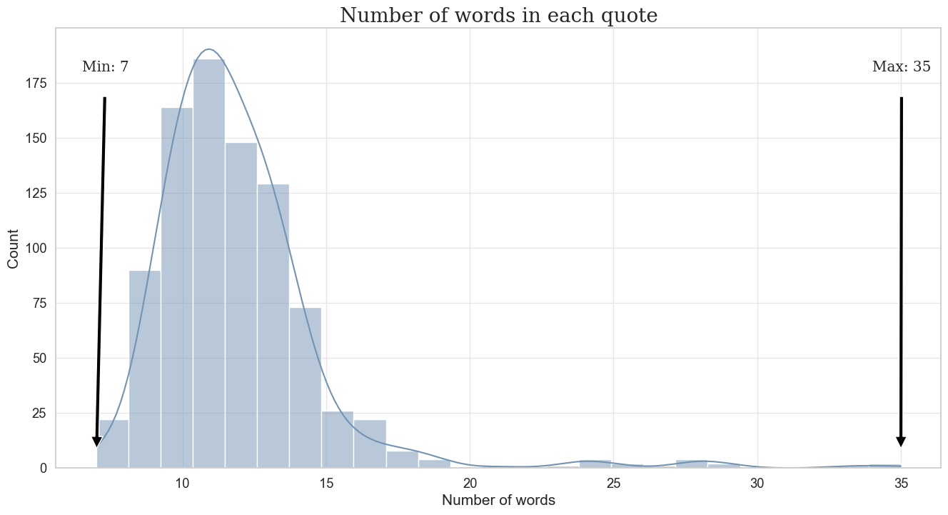
2. EDA

Slide 6
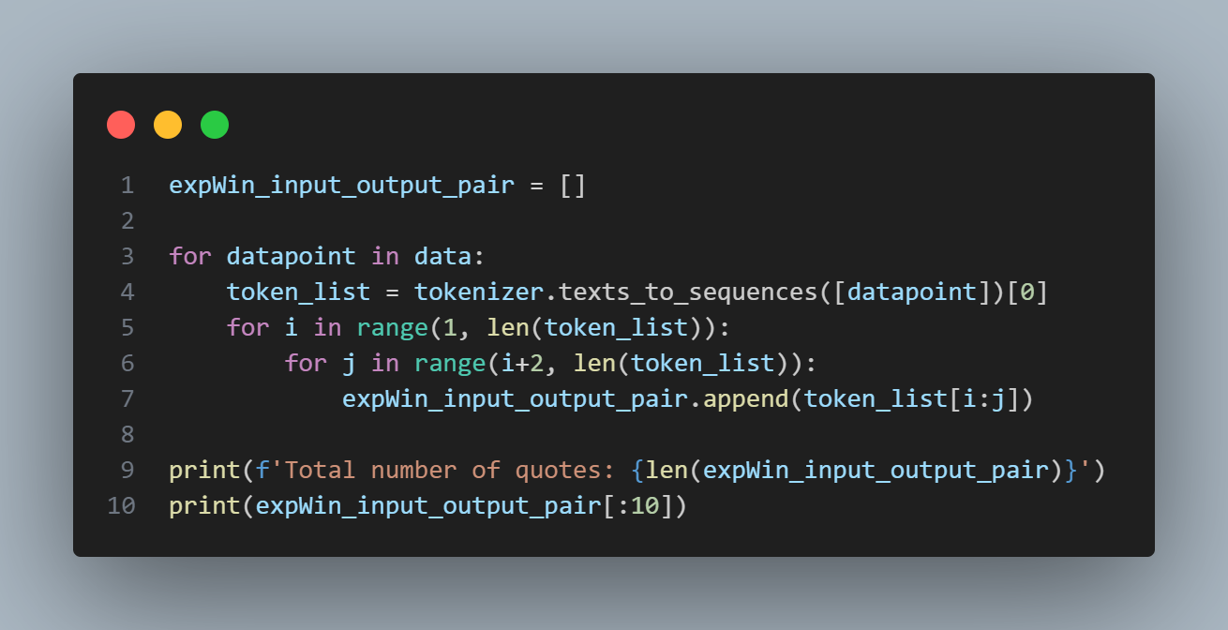
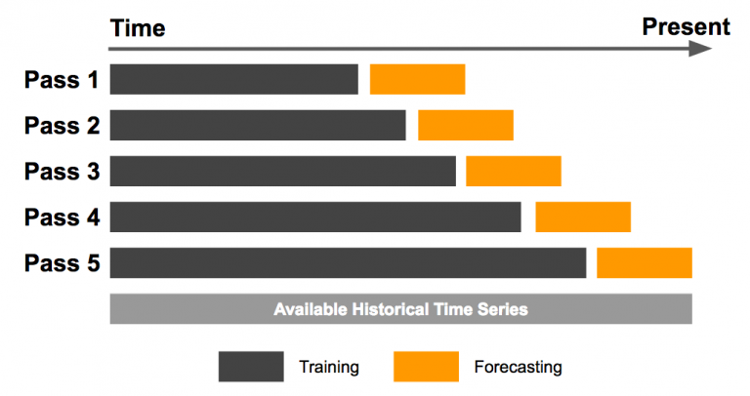
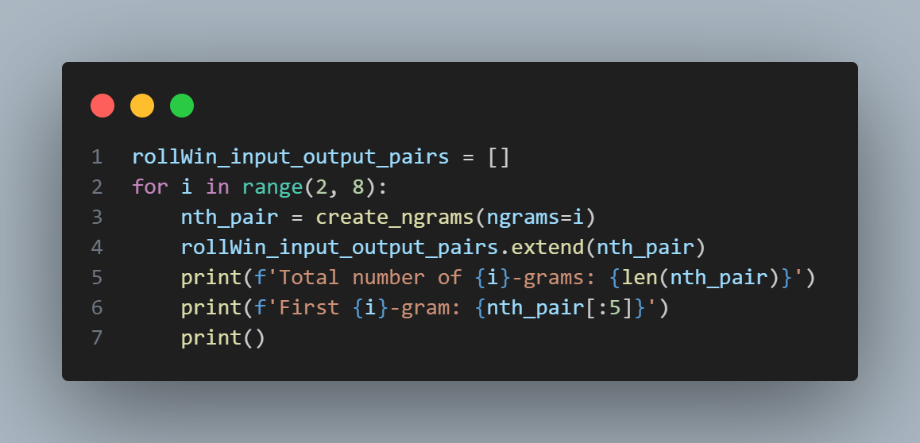
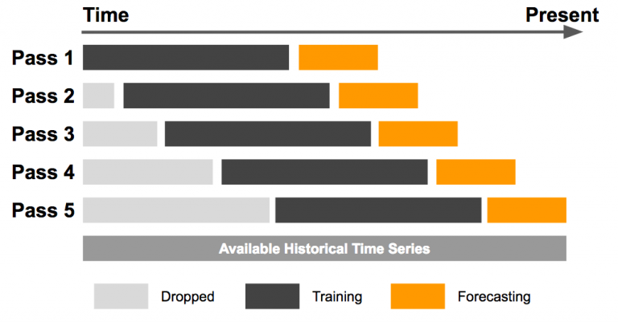
3. Feature Engineering
Expanding Window Technique
Rolling Window Technique

Slide 7
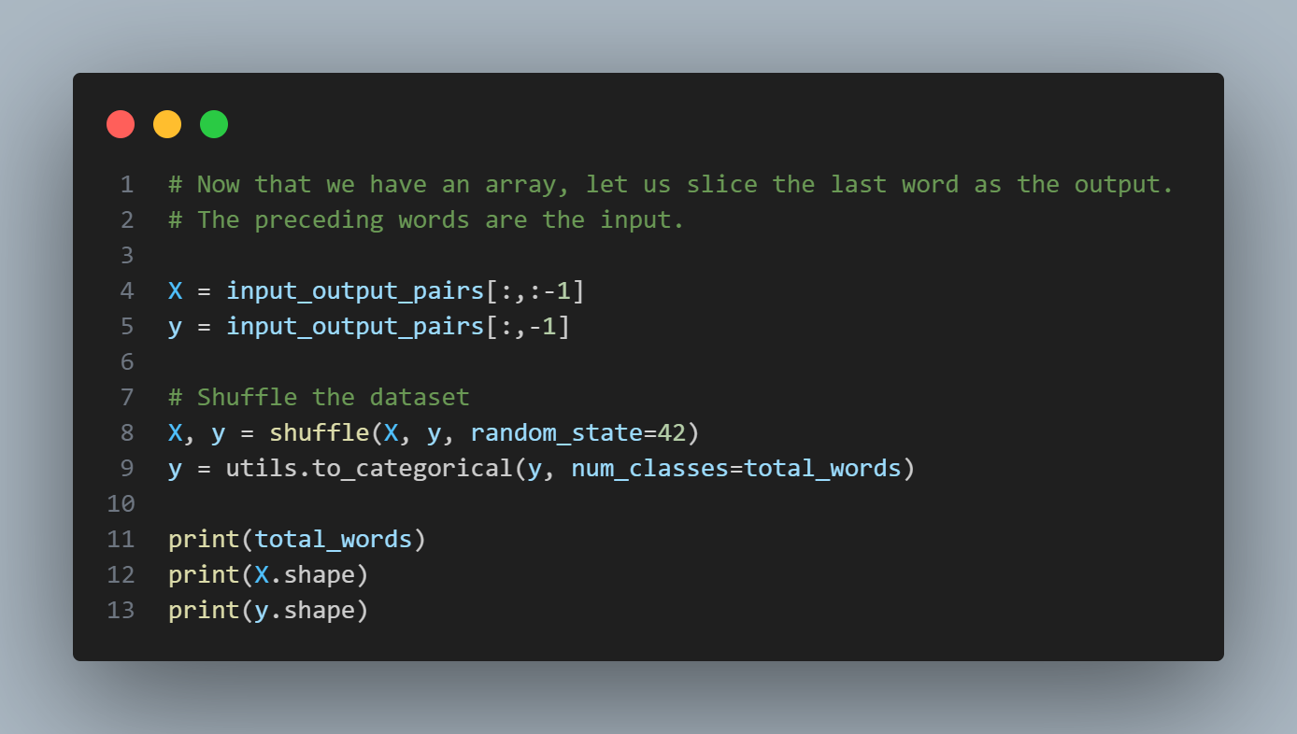
3. Feature Engineering
Total Words: 1199
X shape: (84075, 34)
y shape: (84075, 1199)

Slide 8
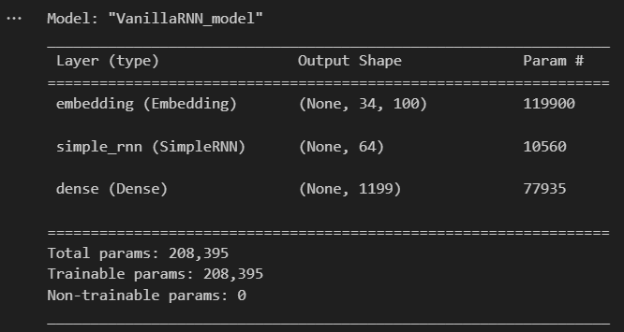
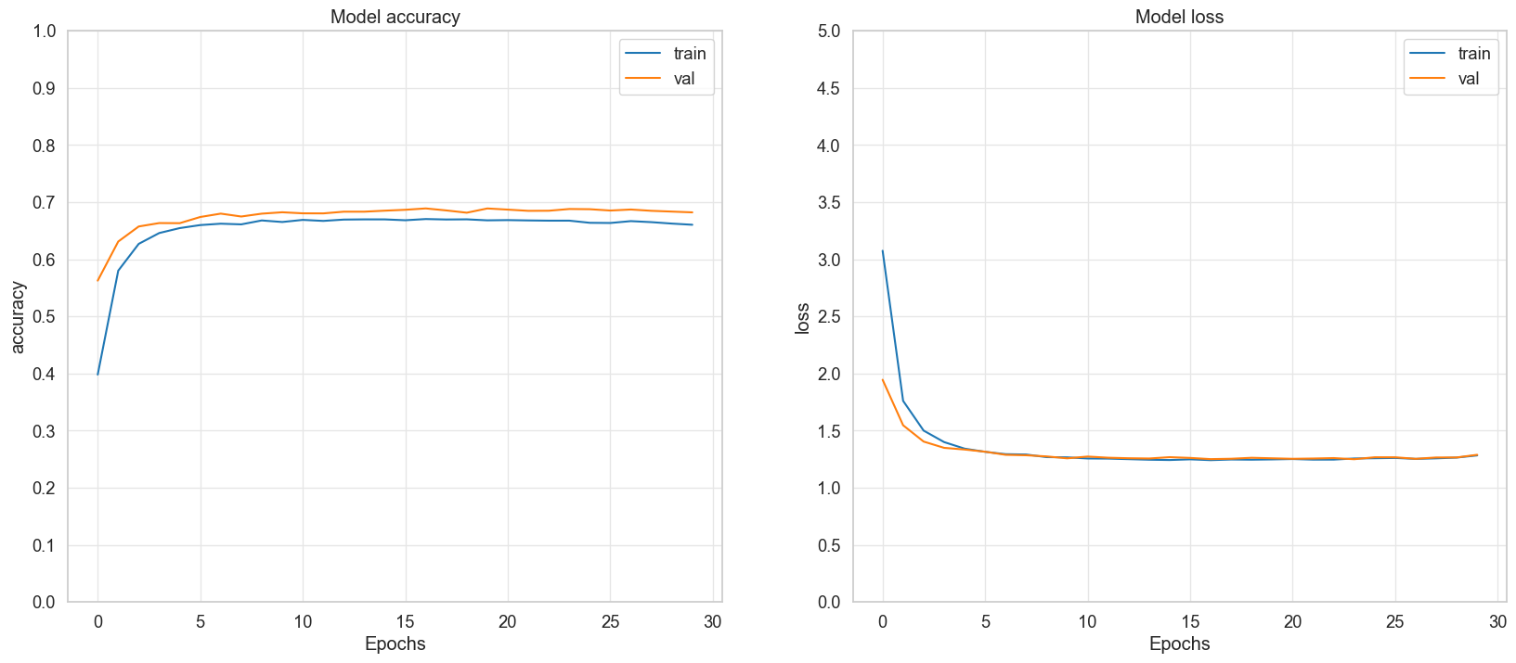
4. Model Training (Baseline Vanilla RNN Model)

Slide 9
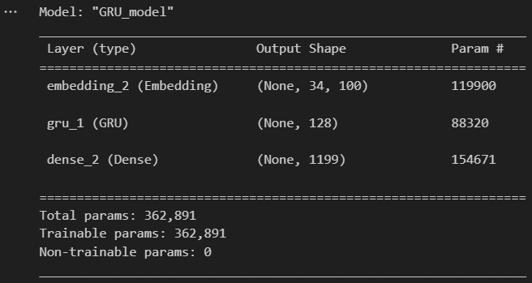
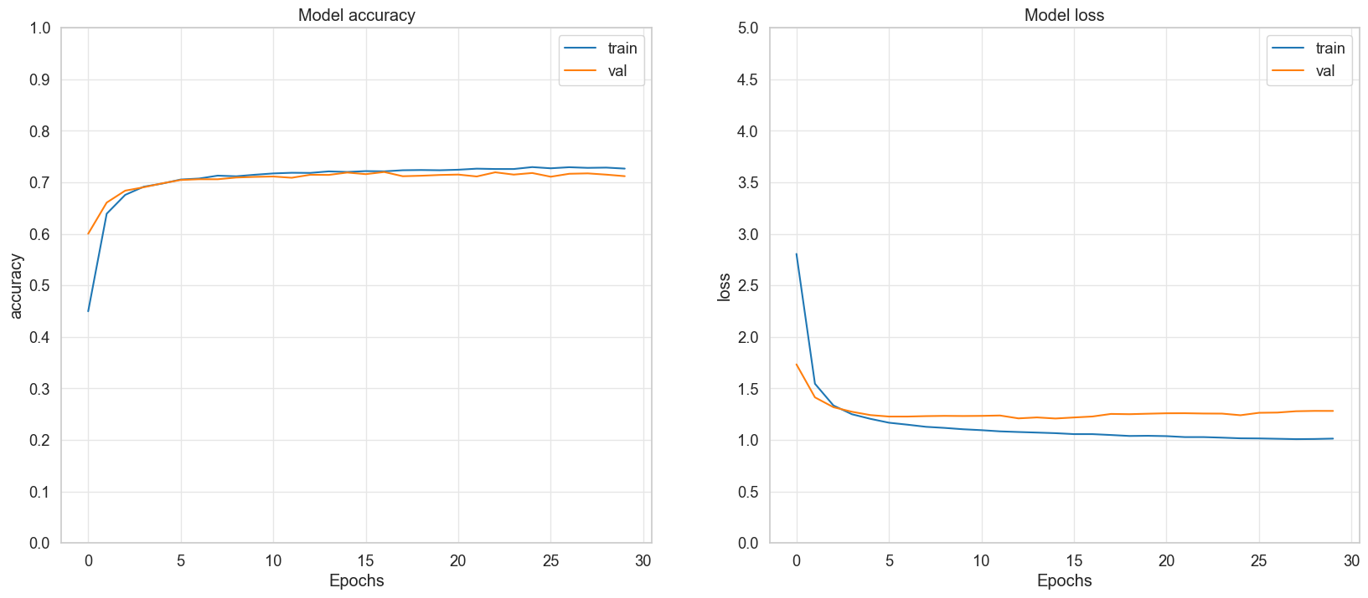
4. Model Training (GRU Model)

Slide 10
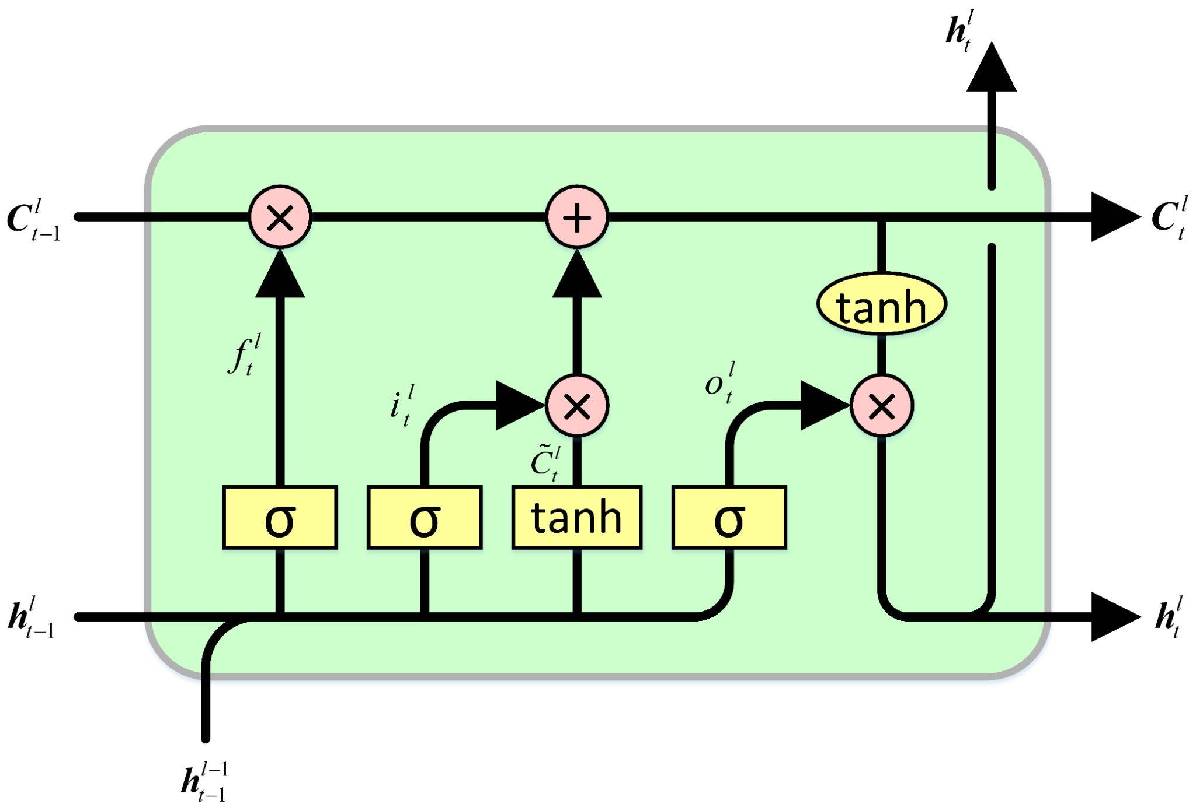
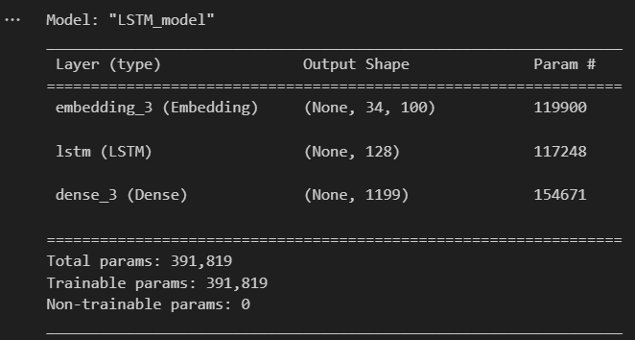
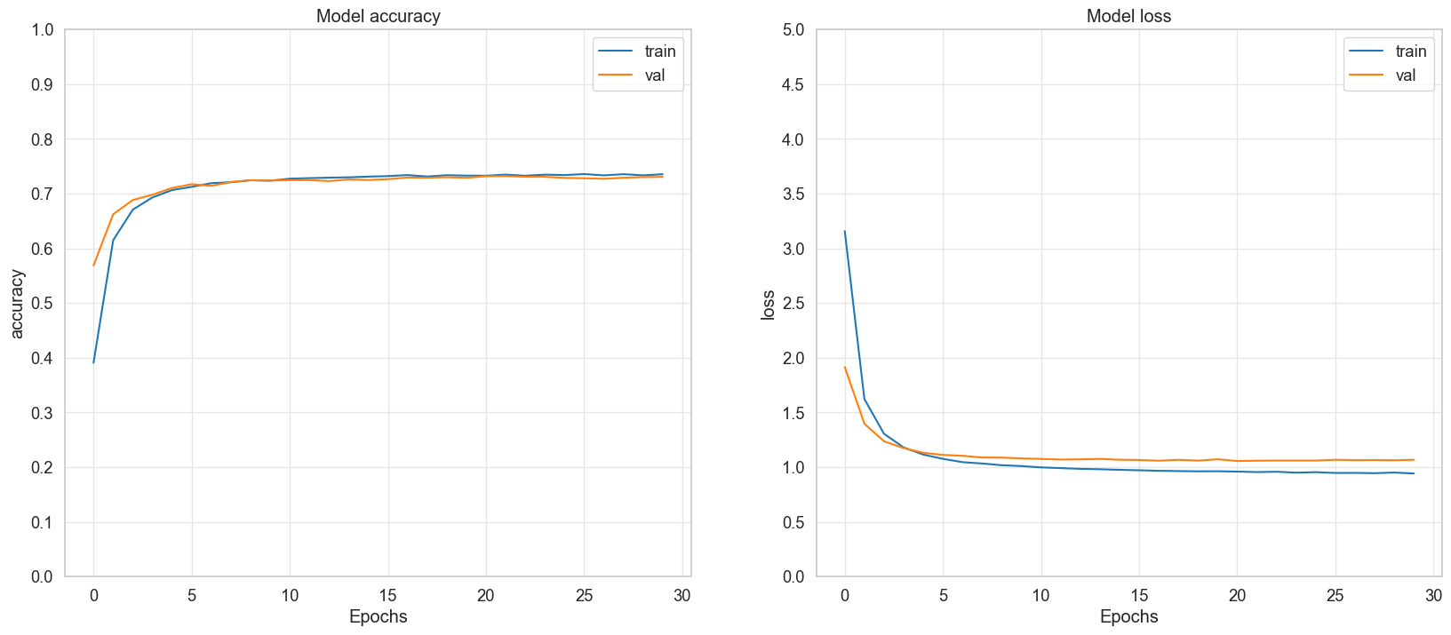
4. Model Training (LSTM Model)

Slide 11
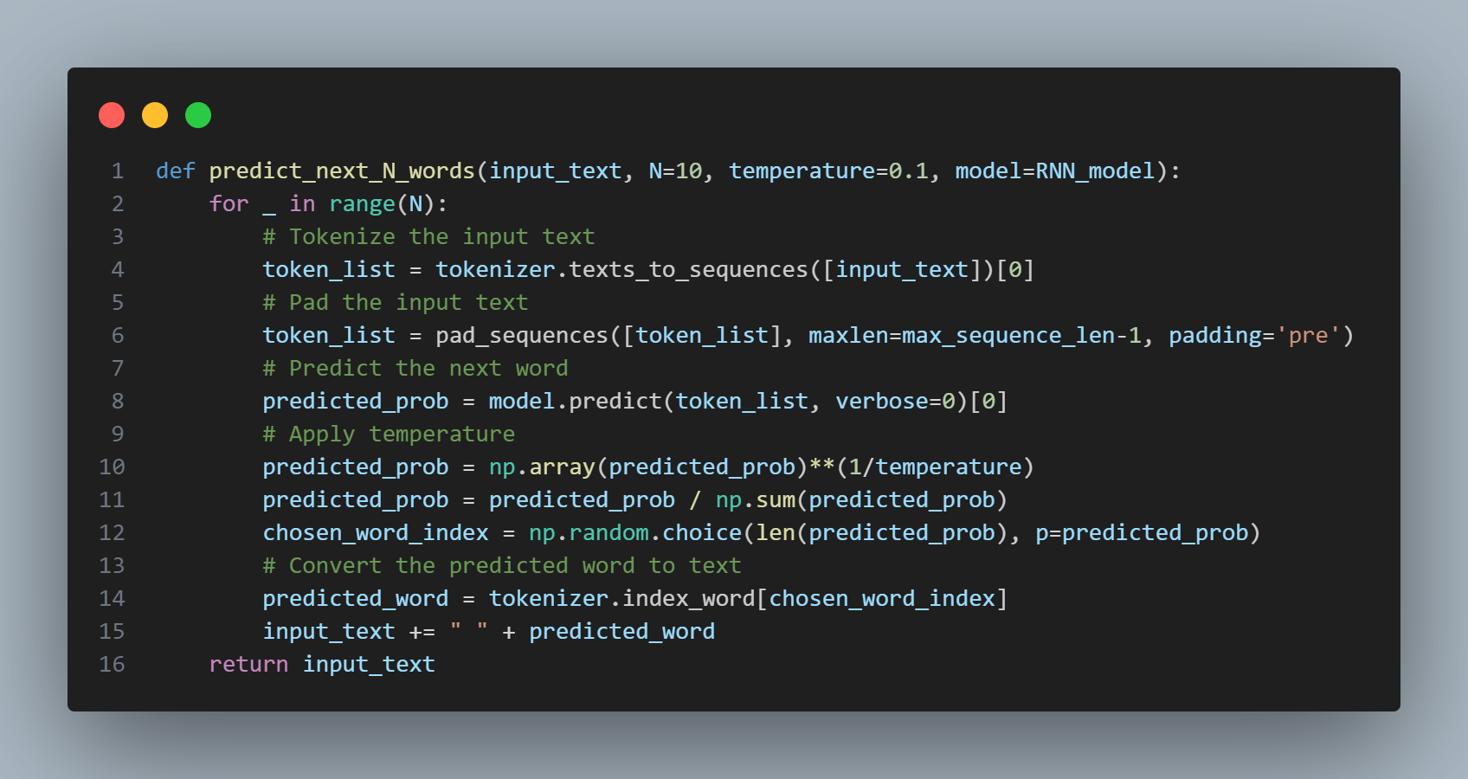
4. Model Training (Using Temperature)
Use Temperature for text generation

Slide 12
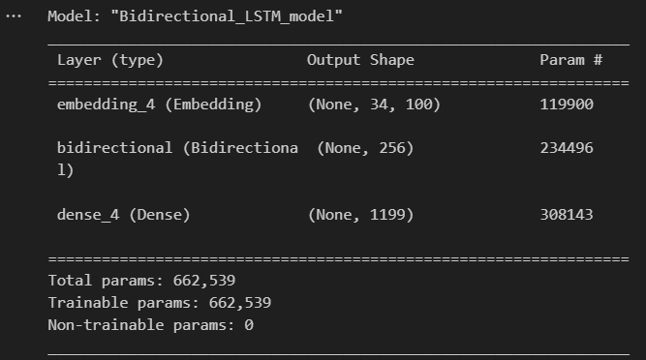
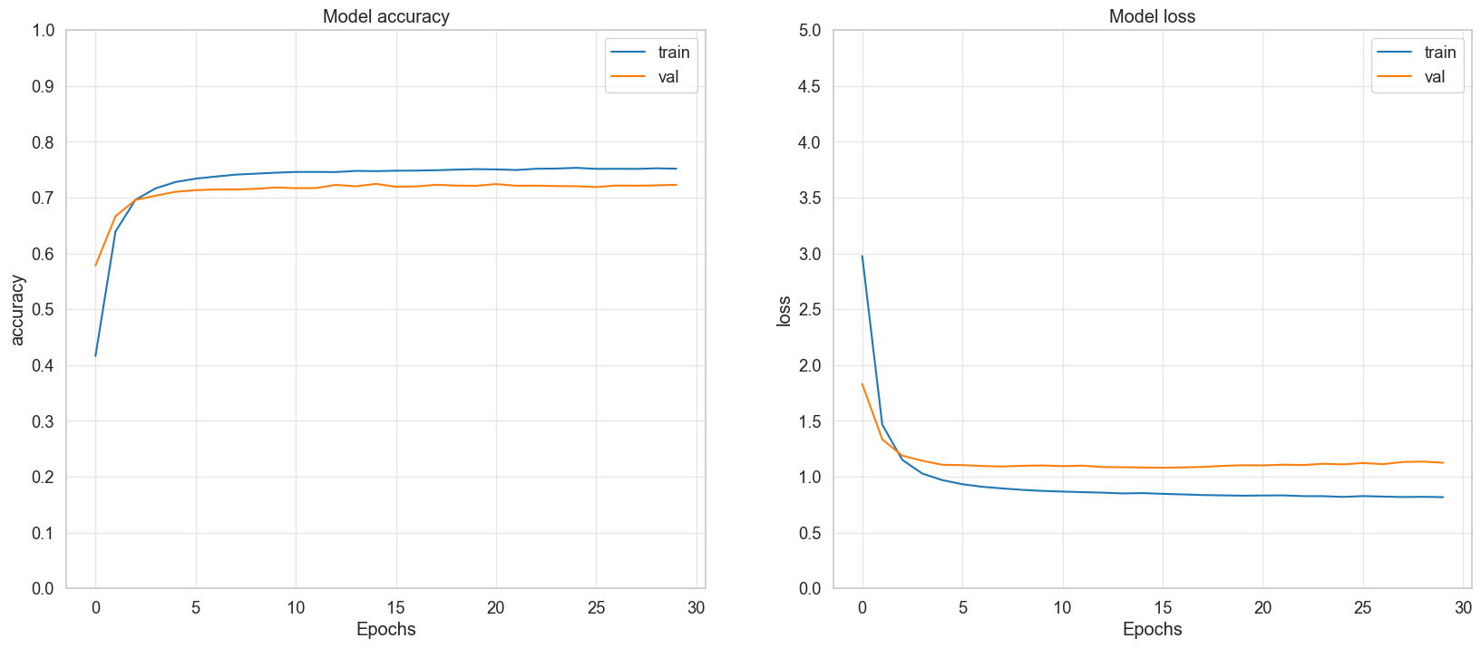
4. Model Training (Bi-directional LSTM Model)

Slide 13
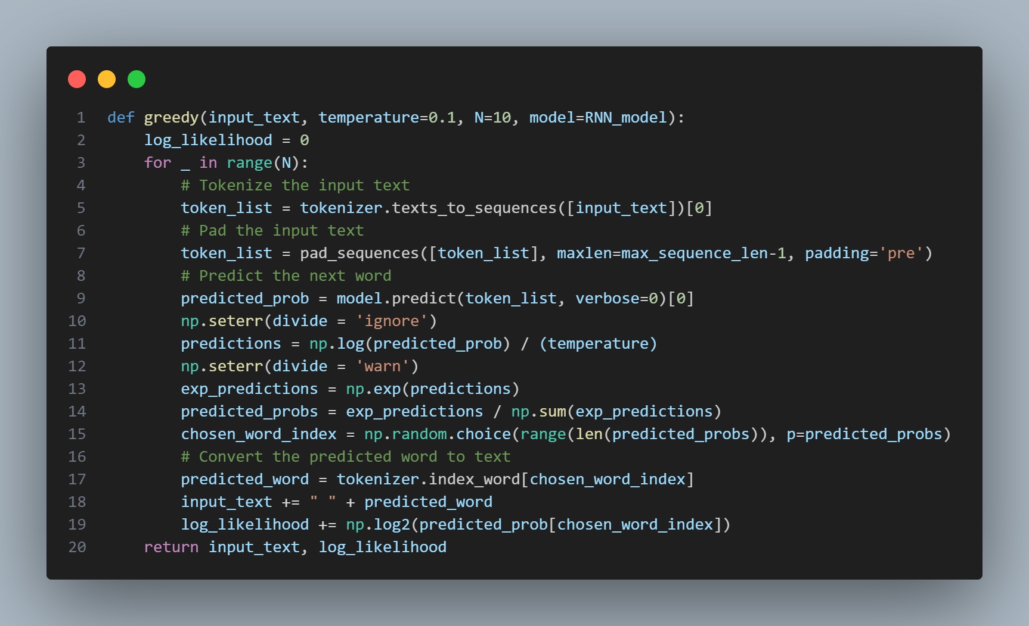
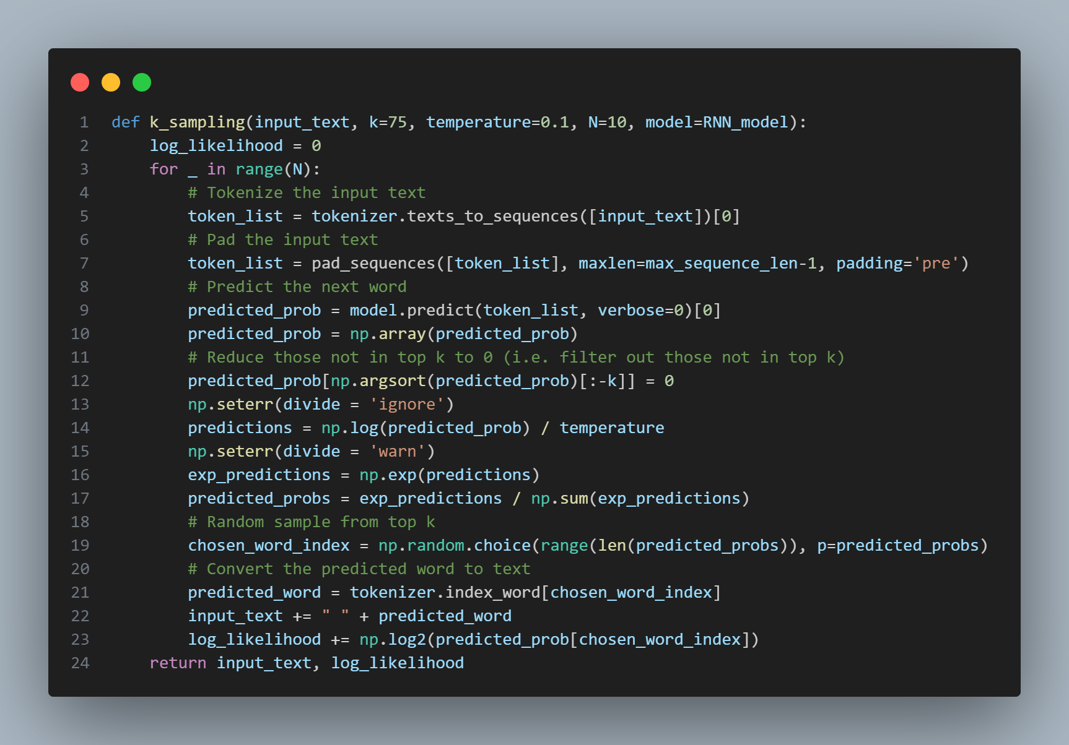
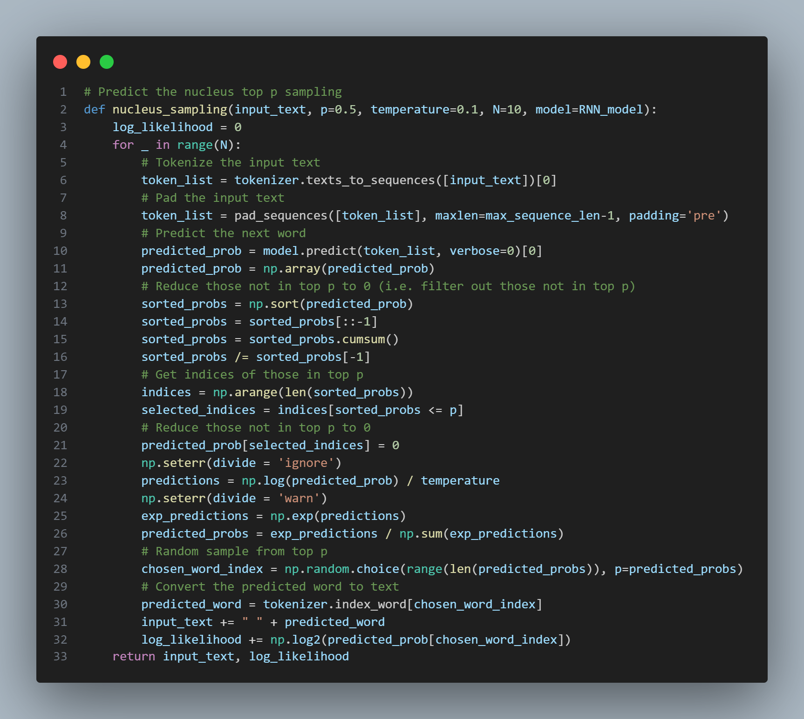
4. Model Training (Decoding Methods)
Greedy
K-Sampling
Nucleus-Sampling

Slide 14
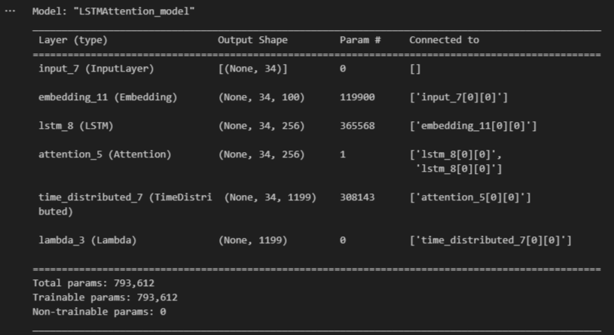
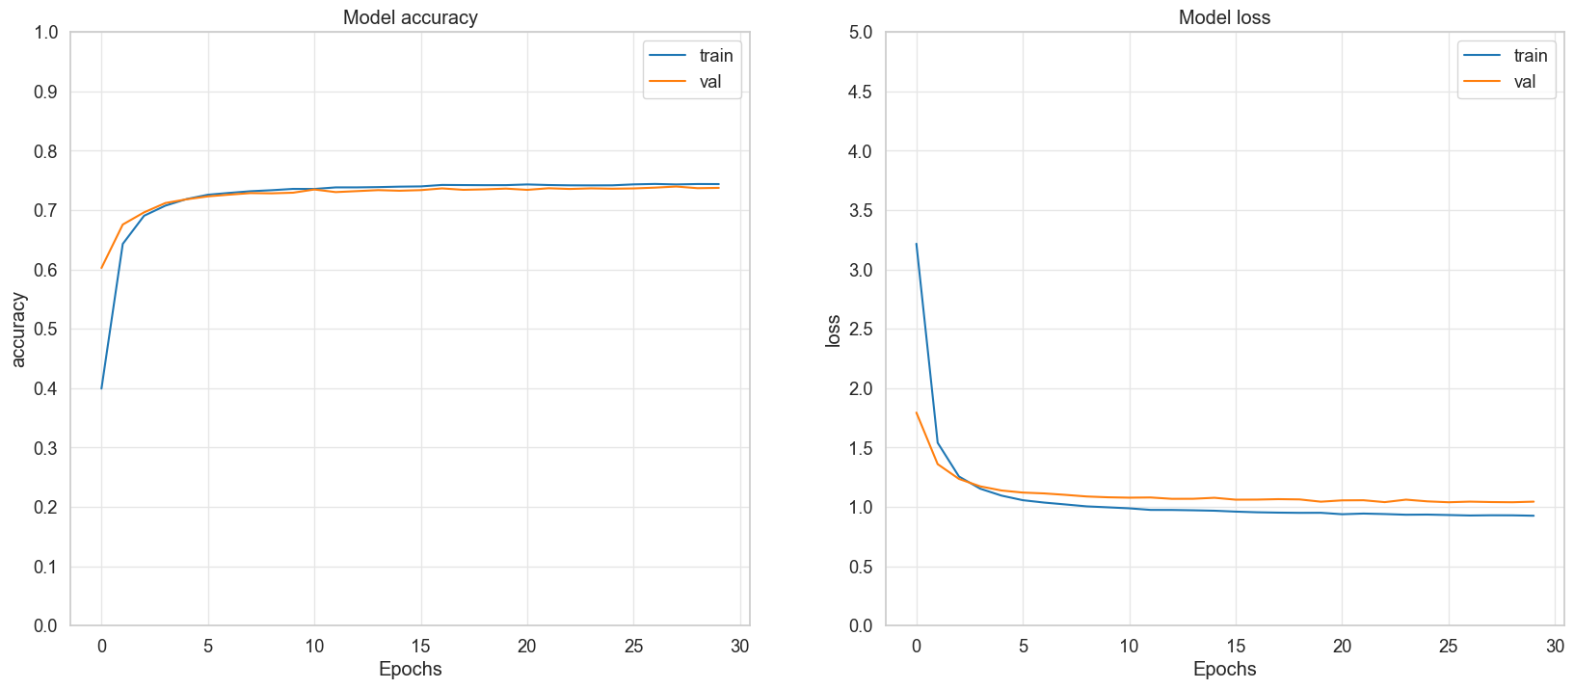
4. Model Training (LSTM Model with Attention Mechanism)

Slide 15
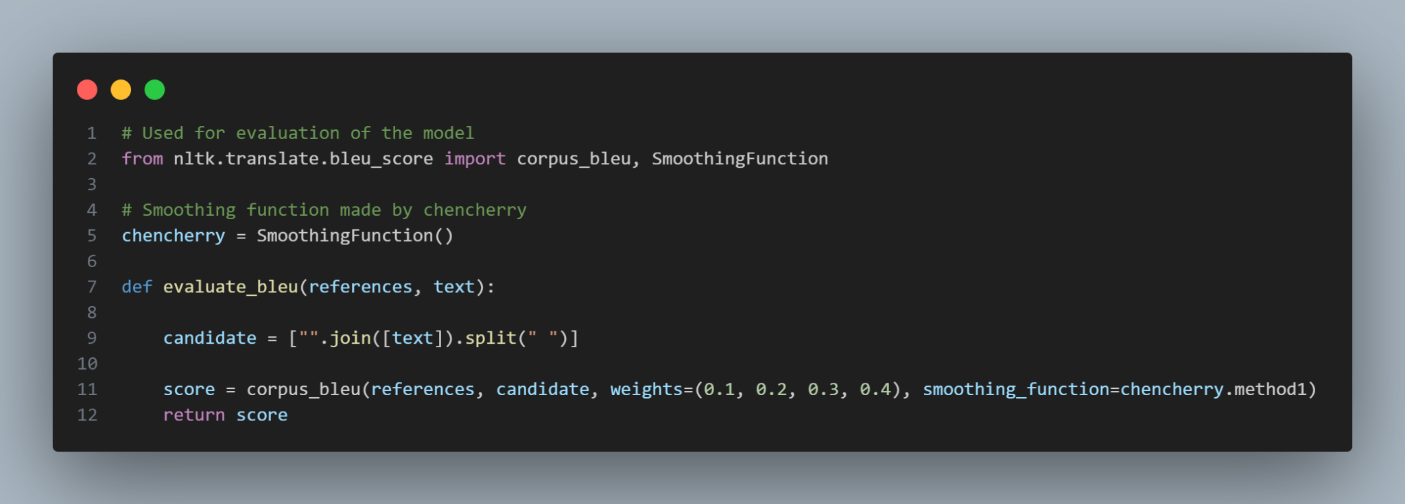
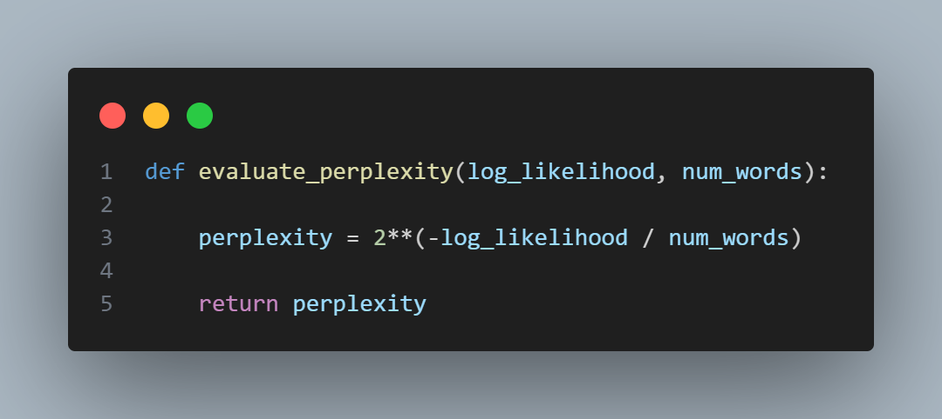
4. Model Training (Evaluation Metrics)
Bleu Score
Perplexity

Slide 16
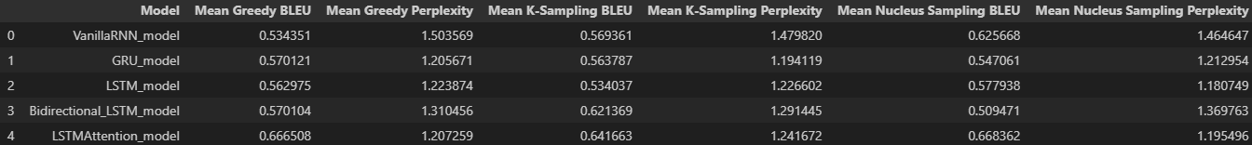
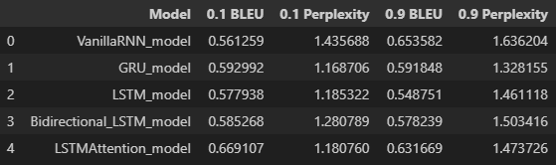
5. Model Evaluation
Evaluate with different decoding methods
Evaluate with different temperature values

Slide 17
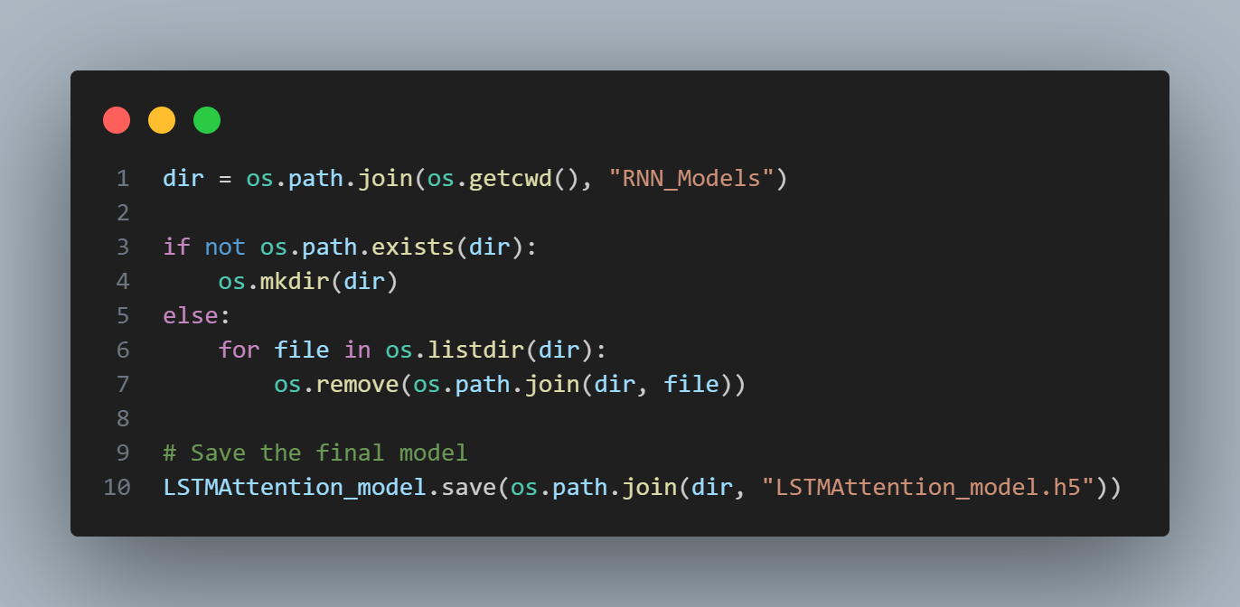
6. Saving the Model
Saving Model Weights

